Slide 1

Chapter 10: Project Communications Management
Information Technology Project Management, Eighth Edition

Slide 2
Importance of Good Communications
The greatest threat to many projects is a failure to communicate
Our culture does not portray IT professionals as being good communicators
Research shows that IT professionals must be able to communicate effectively to succeed in their positions
Strong verbal and non-technical skills are a key factor in career advancement for IT professionals

Slide 3
Project Communications Management Processes
Planning communications management: Determining the information and communications needs of the stakeholders
Managing communications: Creating, distributing, storing, retrieving, and disposing of project communications based on the communications management plan
Controlling communications: Monitoring and controlling project communications to ensure that stakeholder communication needs are met

Slide 4
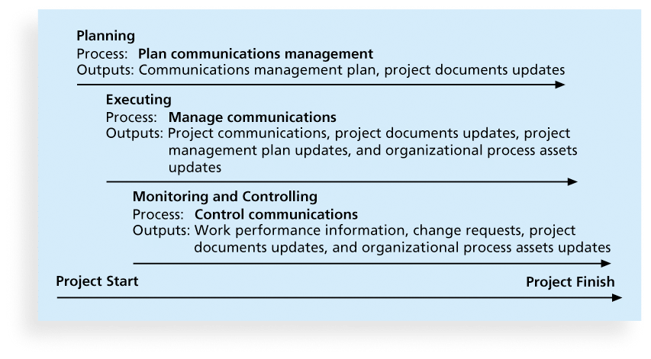
Figure 10-1. Project Communications Management Summary

Slide 5
Keys to Good Communications
Project managers say they spend as much as 90 percent of their time communicating
Need to focus on group and individual communication needs
Use formal and informal methods for communicating
Distribute important information in an effective and timely manner
Set the stage for communicating bad news
Determine the number of communication channels

Slide 6
Importance of Face-to-Face Communication
Research says that in a face-to-face interaction:
58 percent of communication is through body language.
35 percent of communication is through how the words are said
7 percent of communication is through the content or words that are spoken
Pay attention to more than just the actual words someone is saying
A person’s tone of voice and body language say a lot about how he or she really feels

Slide 7
Personal Preferences Affect Communication Needs
Introverts like more private communications, while extroverts like to discuss things in public
Intuitive people like to understand the big picture, while sensing people need step-by-step details
Thinkers want to know the logic behind decisions, while feeling people want to know how something affects them personally
Judging people are driven to meet deadlines while perceiving people need more help in developing and following plans

Slide 8
Encouraging More Face-to-Face Interactions
Short, frequent meetings are often very effective in IT projects
Stand-up meetings force people to focus on what they really need to communicate
Some companies have policies preventing the use of e-mail between certain hours or even entire days of the week

Slide 9
Distributing Information in an Effective and Timely Manner
Don’t bury crucial information
Don’t be afraid to report bad information
Oral communication via meetings and informal talks helps bring important information—good and bad—out into the open

Slide 10
Other Communication Considerations
Rarely does the receiver interpret a message exactly as the sender intended
Geographic location and cultural background affect the complexity of project communications
Different working hours
Language barriers
Different cultural norms

Slide 11
Determining the Number of Communications Channels
As the number of people involved increases, the complexity of communications increases because there are more communications channels or pathways through which people can communicate.
Number of communications channels = n(n-1)
2 where n is the number of people involved

Slide 12
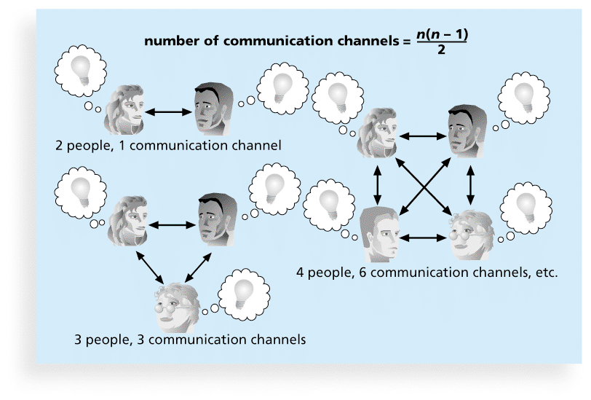
Figure 10-2. The Impact of the Number of People on Communications Channels

Slide 13
Communications Management Plan Contents
1. Stakeholder communications requirements
2. Information to be communicated, including format, content, and level of detail
3. Who will receive the information and who will produce it
4. Suggested methods or technologies for conveying the information
5. Frequency of communication
6. Escalation procedures for resolving issues
7. Revision procedures for updating the communications management plan
8. A glossary of common terminology

Slide 14
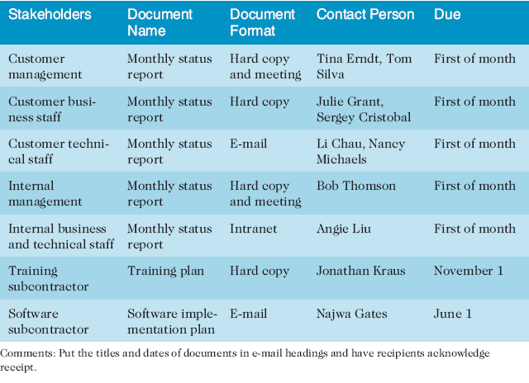
Table 10-1. Sample Stakeholder Analysis for Project Communications

Slide 15
Classifications for Communication Methods
Interactive communication: Two or more people interact to exchange information via meetings, phone calls, or video conferencing. Most effective way to ensure common understanding
Push communication: Information is sent or pushed to recipients without their request via reports, e-mails, faxes, voice mails, and other means. Ensures that the information is distributed, but does not ensure that it was received or understood
Pull communication: Information is sent to recipients at their request via Web sites, bulletin boards, e-learning, knowledge repositories like blogs, and other means

Slide 16
Reporting Performance
Performance reporting keeps stakeholders informed about how resources are being used to achieve project objectives
Status reports describe where the project stands at a specific point in time
Progress reports describe what the project team has accomplished during a certain period of time
Forecasts predict future project status and progress based on past information and trends

Slide 17
Controlling Communications
The main goal of controlling communications is to ensure the optimal flow of information throughout the entire project life cycle
The project manager and project team should use their various reporting systems, expert judgment, and meetings to assess how well communications are working. If problems exist, the project manager and team need to take action, which often requires changes to the earlier processes of planning and managing project communications
It is often beneficial to have a facilitator from outside the project team assess how well communications are working

Slide 18
Suggestions for Improving Project Communications
Develop better communication skills
Run effective meetings
Use e-mail and other technologies effectively
Use templates for project communications

Slide 19
Developing Better Communication Skills
Most companies spend a lot of money on technical training for their employees, even when employees might benefit more from communications training
Individual employees are also more likely to enroll voluntarily in classes to learn the latest technology than in classes that develop soft skills
As organizations become more global, they realize they must invest in ways to improve communication with people from different countries and cultures
It takes leadership to improve communication

Slide 20
Running Effective Meetings
Determine if a meeting can be avoided
Define the purpose and intended outcome of the meeting
Determine who should attend the meeting
Provide an agenda to participants before the meeting
Prepare handouts and visual aids, and make logistical arrangements ahead of time
Run the meeting professionally
Set the ground rules for the meeting
Build relationships

Slide 21
Using E-Mail, Instant Messaging, Texting, and Collaborative Tools Effectively
Make sure that e-mail, instant messaging, texting, or collaborative tools are an appropriate medium for what you want to communicate
Be sure to send information to the right people
Use meaningful subject lines and limit the content of emails to one main subject, and be as clear and concise as possible
Be sure to authorize the right people to share and edit your collaborative documents

Slide 22
Sample Collaborative Tools
A SharePoint portal allows users to create custom Web sites to access documents and applications stored on shared devices
Google Docs allow users to create, share, and edit documents, spreadsheets, and presentations online
A wiki is a Web site designed to enable anyone who accesses it to contribute or modify Web page content
Kanban boards visually show tasks that need to be done, are in progress, or are completed

Slide 23
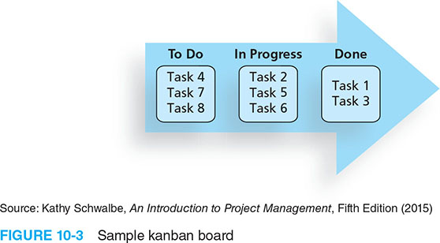
Figure 10-3. Sample Kanban Board

Slide 24
Using Templates for Project Communications
Many technical people are afraid to ask for help
Providing examples and templates for project communications saves time and money
Organizations can develop their own templates, use some provided by outside organizations, or use samples from textbooks
Recall that research shows that companies that excel in project management make effective use of templates

Slide 25
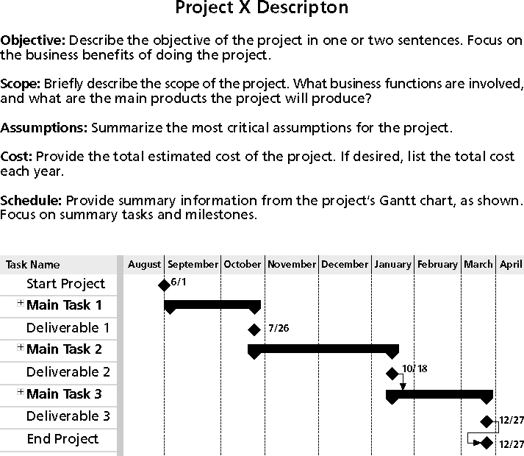
Figure 10-3. Sample Template for a Project Description

Slide 26
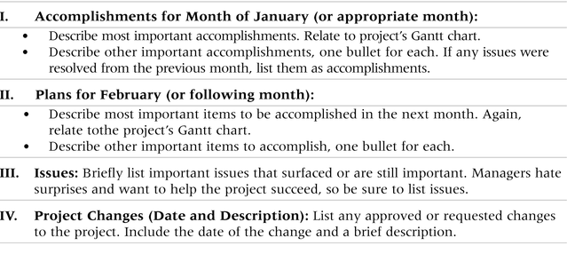
Table 10-3. Sample Template for a Monthly Progress Report

Slide 27
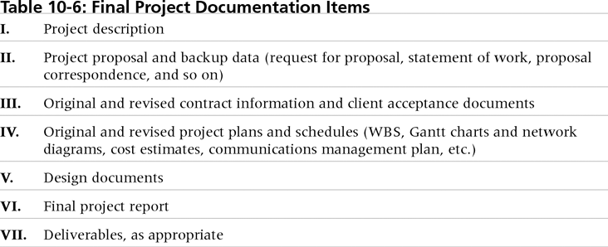
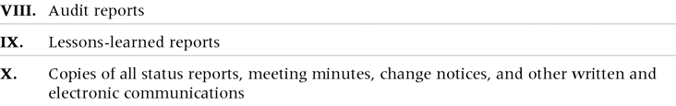
Table 10-4. Final Project Documentation Items

Slide 28
Lessons Learned Reports
The project manager and project team members should each prepare a lessons-learned report
A reflective statement that documents important things an individual learned from working on the project
The project manager often combines information from all of the lessons-learned reports into a project summary report
See template and sample in Chapter 3

Slide 29
Project Archives
It is also important to organize and prepare project archives
Project archives are a complete set of organized project records that provide an accurate history of the project
These archives can provide valuable information for future projects as well

Slide 30
Project Web Sites
Many project teams create a project Web site to store important product documents and other information
Can create the site using various types of software, such as enterprise project management software
Several project management tools can be used on multiple devices

Slide 31
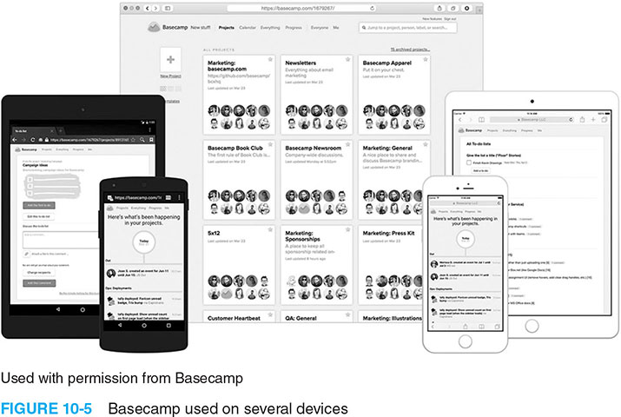
Figure 10-5. Basecamp Used on Several Devices

Slide 32
Chapter Summary
The goal of project communications management is to ensure timely and appropriate generation, collection, dissemination, storage, and disposition of project information
Main process include:
Plan communications management
Manage communications
Control communications

